Slide 1
Mission Planner
Use slide 2 for planning, make a copy of the slide for each run
Slide 3 onwards are example plans
Read them to have an idea of how to plan
Don’t copy them; they are not good plans
The images for the energy units, fuel truck, etc are moveable, use them to keep track of their location

Slide 2
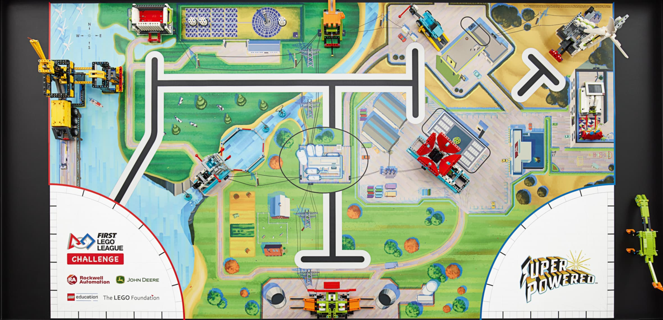
RUN:
Need 3
Need 1
Need 3
Need 3
+
Innovation
Need 3
Notes:

Slide 3
RUN: Example run 1
Need 3
Need 1
Need 3
Need 3
+
Innovation
Need 3
Notes:
- Move 3 blocks from solar farm (M04) to hydrogen plant (M13)
- Flip the smart grid (M05)
- Retrieve one energy unit from energy storage (M03) and bring home

Slide 4
RUN: Example run 2
Need 3
Need 1
Need 3
Need 3
+
Innovation
Need 3
Notes:
- <Start with one energy unit in home and 3 in hydrogen>
- Put innovation project model (M01) into hydrogen plant
- Retrieve one energy unit from power plant (M10), remaining 2 should roll into east and west

Slide 5
RUN: Example run 3
Need 3
Need 1
Need 3
Need 3
+
Innovation
Need 3
Notes:
- Bring 3 energy units to energy storage (M03)
- Load fuel units into fuel truck (M02) and bring fuel truck into home

