Slide 1
Mission Planner
Use slide 4 for planning, make a copy of the slide for each run
You can reposition your robot and start a different program when it is at least partially in the loading bay

Slide 2
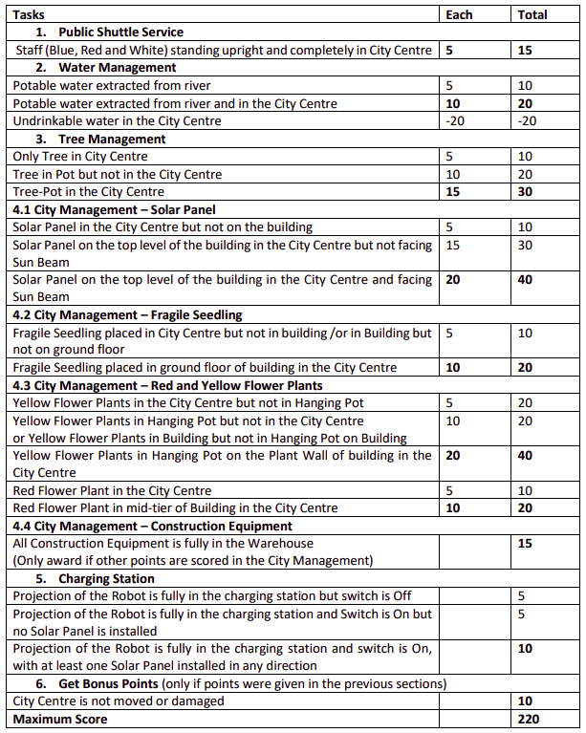

Slide 4
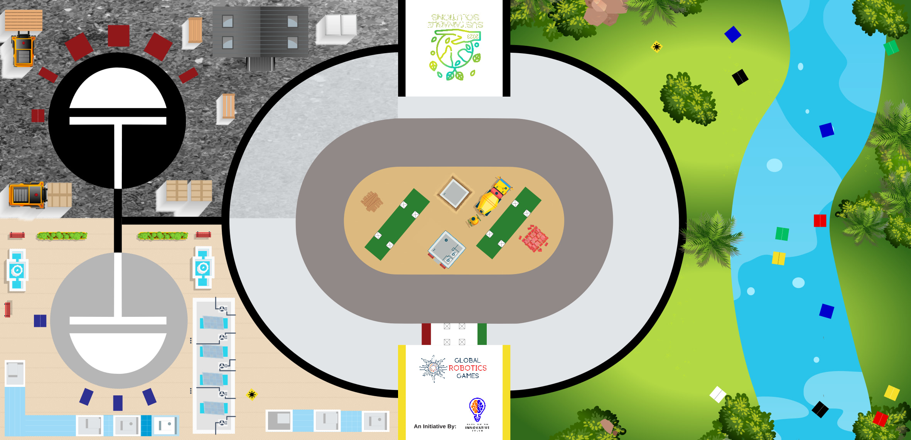
RUN:
Notes:

